Slide 1
Chapter 1 Managing Data Using SQL

Slide 2

Database and SQL Statement
1.1
Database is a collection of structured data in a computer system that facilitates the storage and retrieval of data.
It is designed in a manner that allows us to store a large amount of data efficiently.

Slide 3
What is a database?
A
Database management includes the following three tasks:
Retrieval of information from a database
Modification, deletion and insertion of data in a database
Modification on database structure so as to meet the changing needs

Slide 4

What is a database?
A
The following are some examples of the application of databases in our daily life.

Slide 5
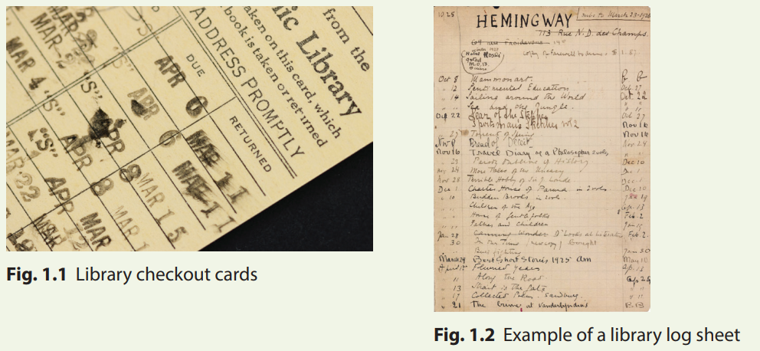
1.1
Finish Activity 1.1 on P. 5 of your textbook.
When borrowing books from the library, have you ever seen a card under the cover of the borrowed book?

Slide 6
1.1
Traditional method | Online library management system

Slide 7
1.1
Traditional method | Online library management system
Data is recorded on the checkout cards and log books | Data is stored in the online system
Data must be searched manually from a physical copy of checkout cards or log books | Data can be searched by the system in a relatively short time

Slide 8
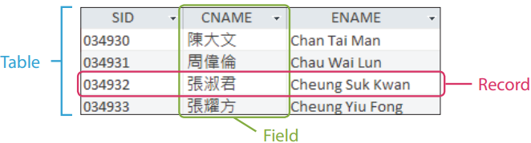
Database Structure
B
A database organises data as fields, record and tables.
Field: A single piece of information.
Record: One complete set of fields.
Table: A collection of records.

Slide 9
1.2
Finish Activity 1.2 on P. 6 of your textbook.
DVD ID; DVD name, DVD price, age restriction of DVD, etc.
Member ID, member name, member contact, member age, etc.
Member ID, DVD ID, rent date, due date, payable amount, etc.

Slide 10
Database Structure
B
A poor database design may lead to problems such as:
Causing data to be inaccurate
Degraded performance
Loss of flexibility

Slide 11
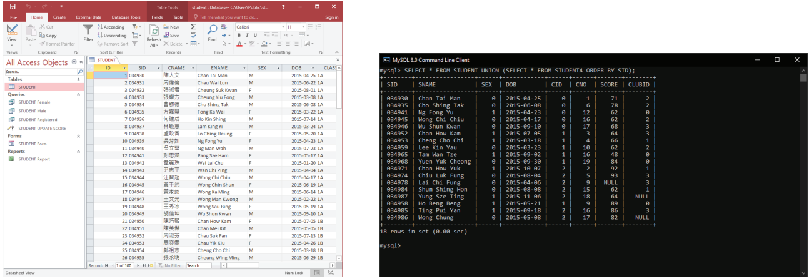
Database Structure
B
We often use a database management system (DBMS) to help us manage databases.
For example, Microsoft Access is a DBMS with a graphical user interface (GUI), while MySQL is a DBMS which allows us to manage databases without a GUI.

Slide 12
SQL statement
C
We use queries to filter, sort, summarise, update or delete data in a DBMS. These queries are written in Structured Query Language (SQL).
Here is a quick summary of common SQL keywords which we have learnt in the Compulsory Part.
Function | Keywords
Retrieval | SELECT FROM
Summarisation | GROUP BY
Filtering | WHERE/HAVING
Sorting | ORDER BY

Slide 13
Creating Databases and Tables
1.2
In this section, we are going to create a database including a table filled with data using SQL statements in a DBMS named MySQL.

Slide 14
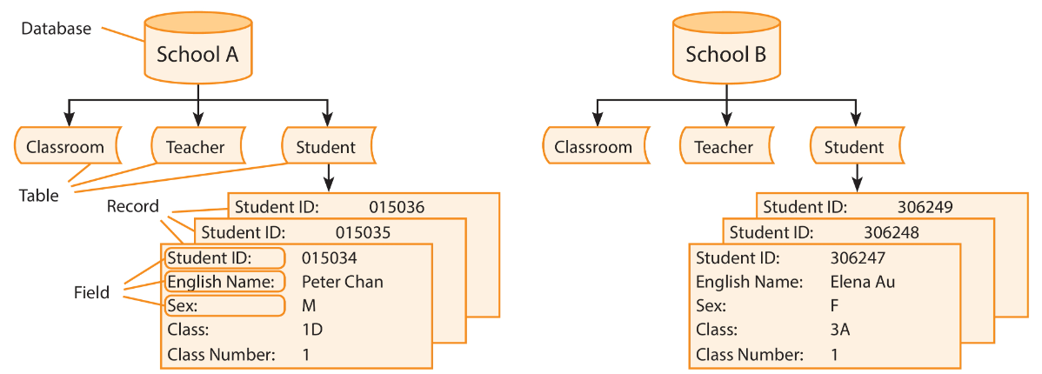
SHOW DATABASES
A
In a DBMS, there can be multiple databases.

Slide 15
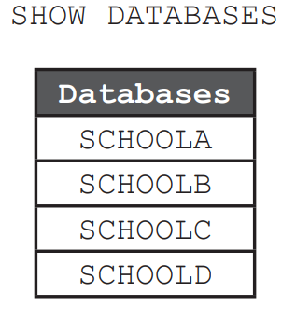
SHOW DATABASES
A
Command SHOW DATABASES gets a list of the databases in MySQL.

Slide 16
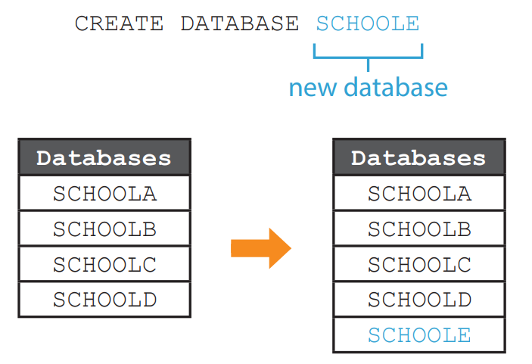
CREATE DATABASE
B
If we do not want to use any existing databases, we may create a new database.

Slide 17
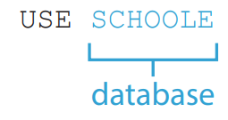
USE
C
Whenever we start MySQL, we must specifies which database to use before manipulating any data from tables.

Slide 18
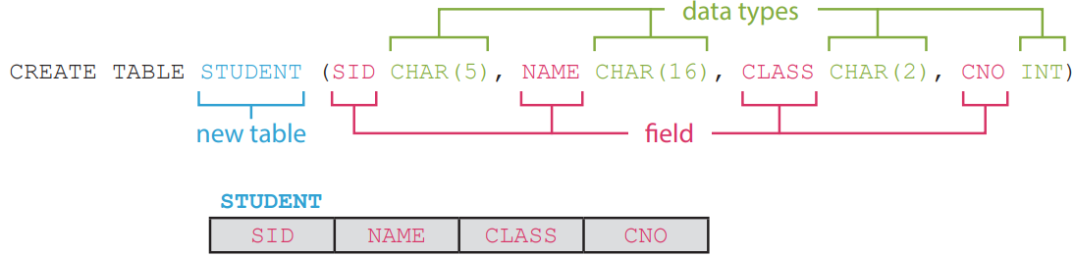
CREATE TABLE
D
To store data, we should create a table inside the newly created database first.
The SQL statement below creates a table named STUDENT with four fields:
SID (student identity number),
NAME (student name),
CLASS (class name) and
CNO (class number).

Slide 19
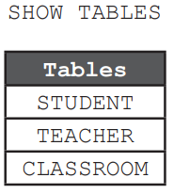
SHOW TABLES
E
Command SHOW TABLES gets a list of the tables in the current database.

Slide 20
1.1
Finish Lab 1.1 on P. 11 of your textbook.
No
Yes
Yes
Yes

Slide 21

1.3
Finish Activity 1.3 on P. 12 of your textbook.
A | SHOW DATABASE
B | show database
A | CREATE DATABASE CITY CENTRE
B | CREATE DATABASE TOWNCENTRE
A | create table shop (id, name, location)
B | create table shop (id int, name char(30))
A | CREATE TABLE HOTEL (hid INT, hname CHAR(40), address CHAR(40))
B | CREATE TABLE HOTEL (HID INT, HNAME CHAR(40), HADDRESS CHAR(40)

Slide 22
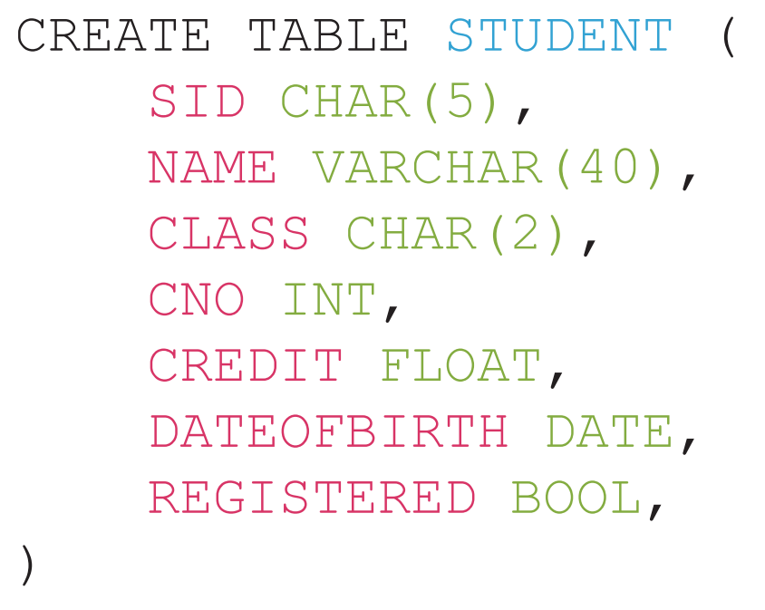
Data Type
1.3
When creating a table, we have to define the data type of each field in the table.

Slide 23
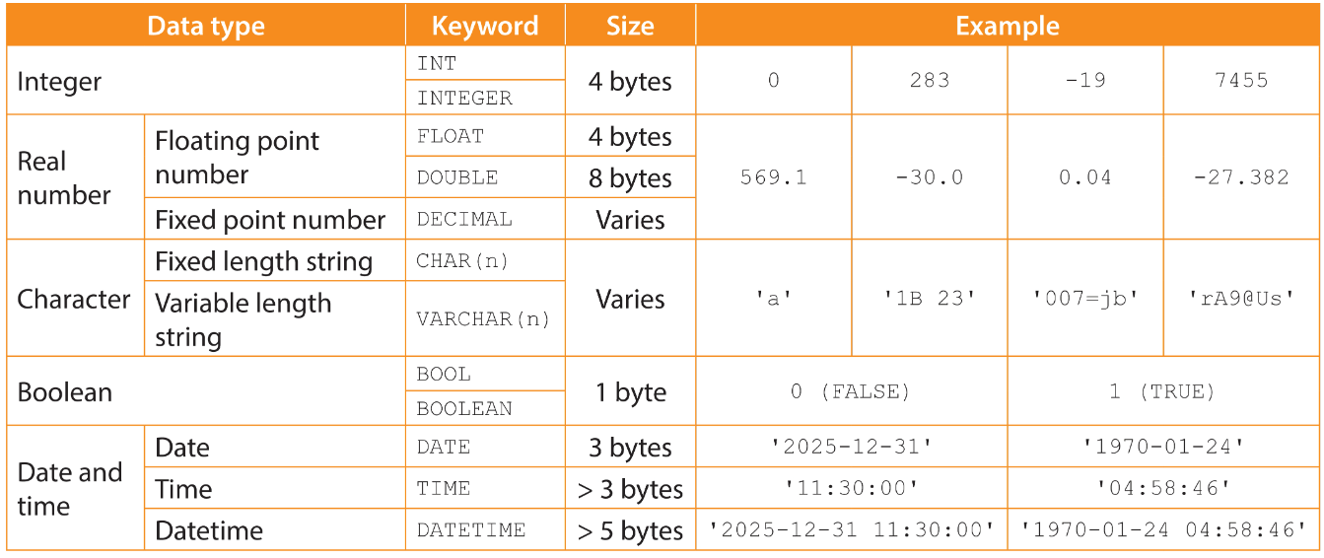
Data Type
1.3
List of common data types in DBMS

Slide 24
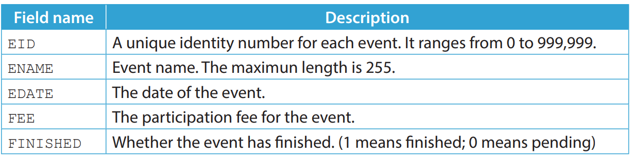
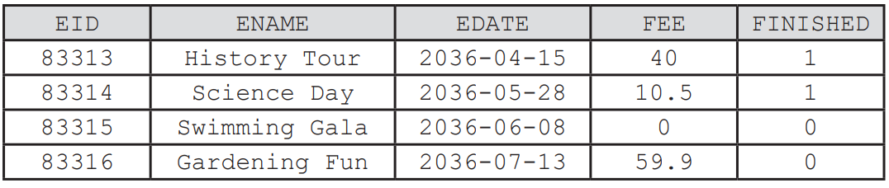
1.1
A teacher wants to create a table named EVENT to store the data of school events.
Here is the table structure of EVENT.
The data to be stored in the mentioned table is shown below.
Write a SQL statement to create the mentioned table. Choose data types that will mostly likely minimise the storage size of the table.

Slide 25
1.1
◣ Solution
CREATE TABLE EVENT ( EID INT, ENAME VARCHAR(255), EDATE DATE, FEE FLOAT, FINISHED BOOL )
INT can be written as INTEGER. BOOL can be written as BOOLEAN. ENAME can be CHAR(255). FEE can be DECIMAL.

Slide 26
1.1
Finish Checkpoint 1.1 on P. 16 of your textbook.
CREATE TABLE NOTICE ( NID INT, PID INT, CONTENT VARCHAR(255) , EXPIRY DATETIME )
CREATE TABLE MEMBER (MID CHAR(5), MNAME VARCHAR(40), VIP BOOL, AGE INT, CREDIT FLOAT)

Slide 27
Inserting and Retrieving Data
1.4
In this section, we are going to store data in and retrieve data from a table.

Slide 28
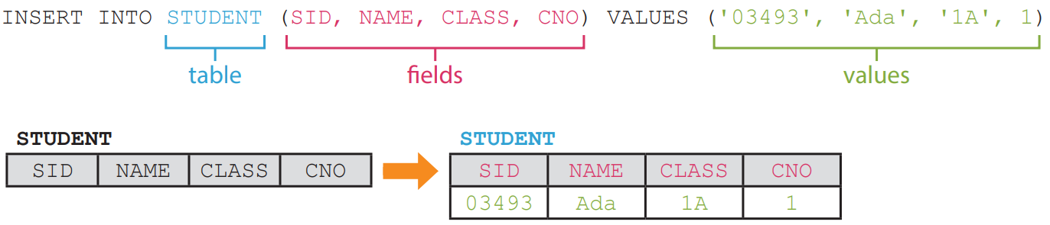
INSERT INTO ... VALUES
A
The SQL statement below inserts a record of a student into the table STUDENT.

Slide 29
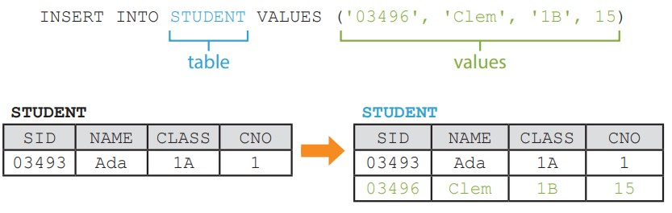
INSERT INTO ... VALUES
A
If you arrange the values in the same order as the fields in the table, you do not have to specify the fields.

Slide 30
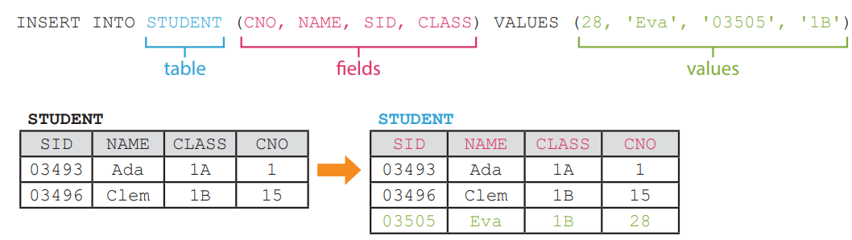
INSERT INTO ... VALUES
A
However, if you specify the fields, you can arrange the values in any order.

Slide 31
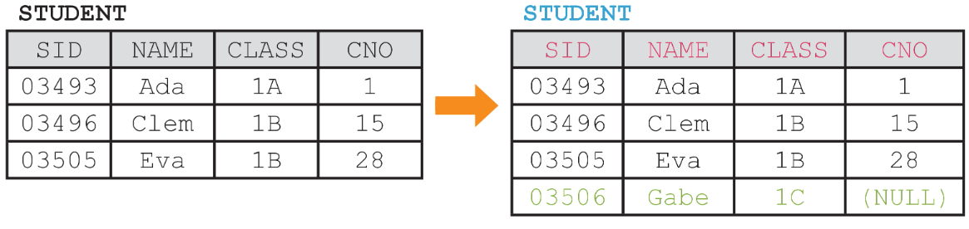
INSERT INTO ... VALUES
A
We may leave a field empty during insertion. In such a case, this field will have a NULL value, i.e. a lack of value.

Slide 32
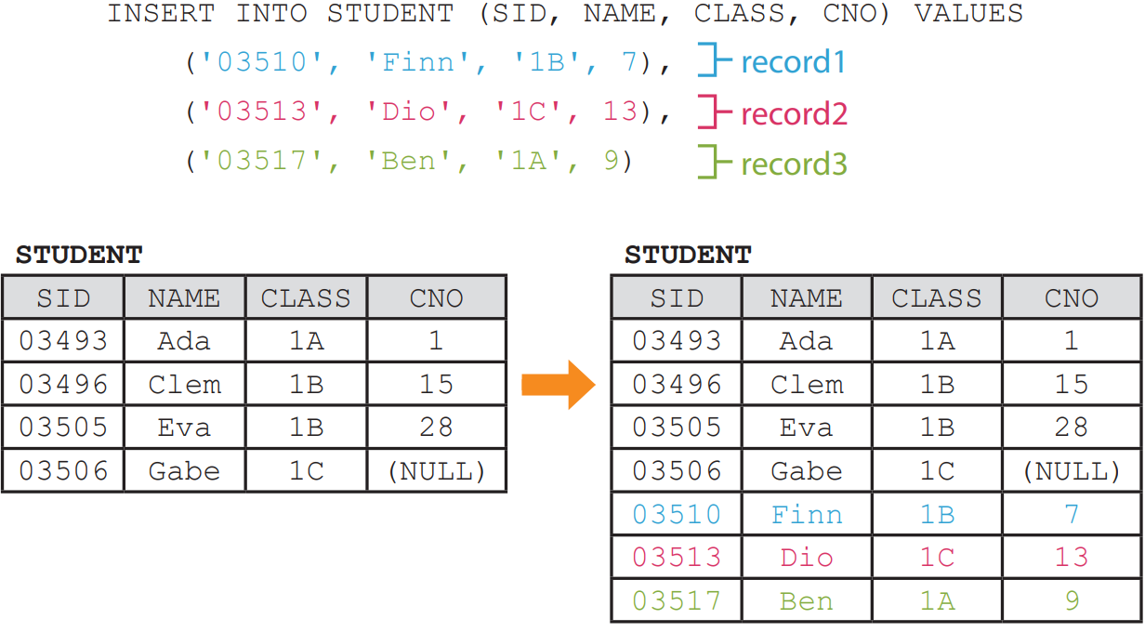
INSERT INTO ... VALUES
A
We may insert more than one record at a time. Use comma to separate the records.

Slide 33
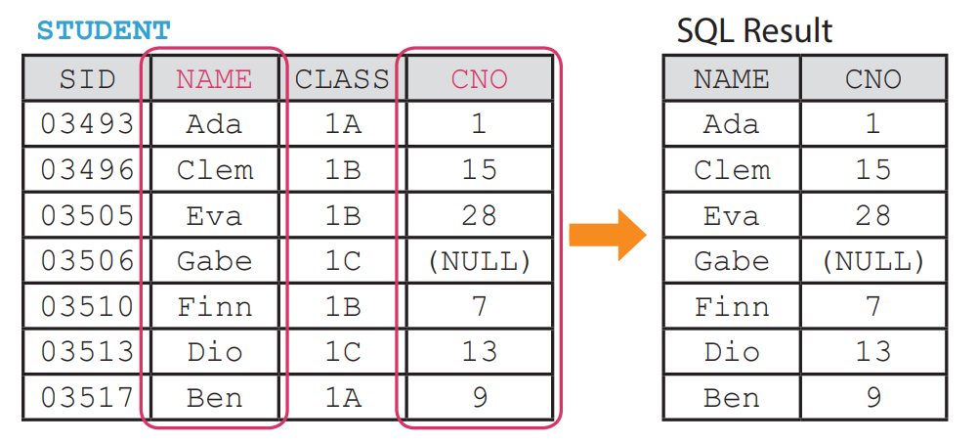
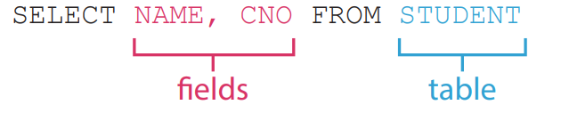
SELECT … FROM
B
After insertion, we may retrieve the data from specific fields of a table using SELECT FROM.
The SQL statement below retrieves the data from the fields CNO and CLASS from the table STUDENT.

Slide 34
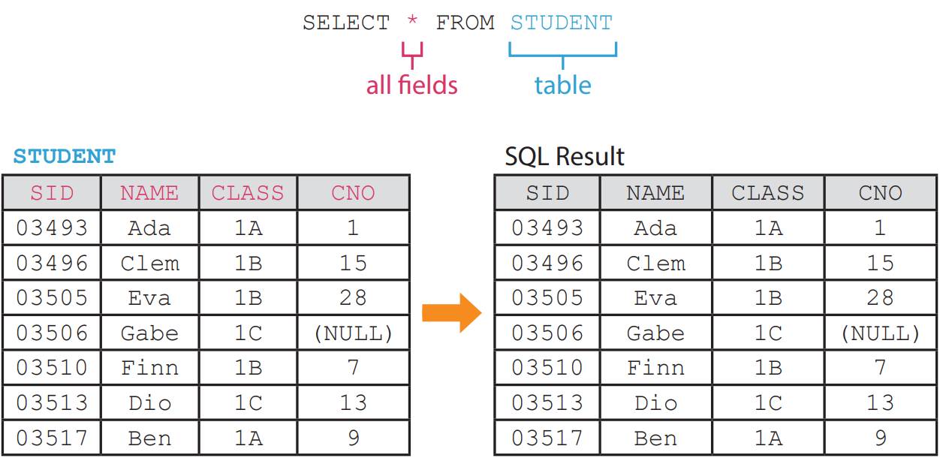
SELECT … FROM
B
We may also retrieve the data from all fields of a table using a wildcard *.

Slide 35
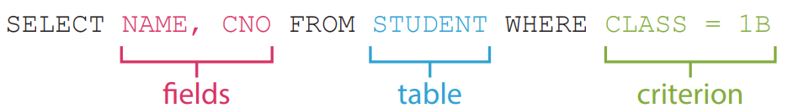
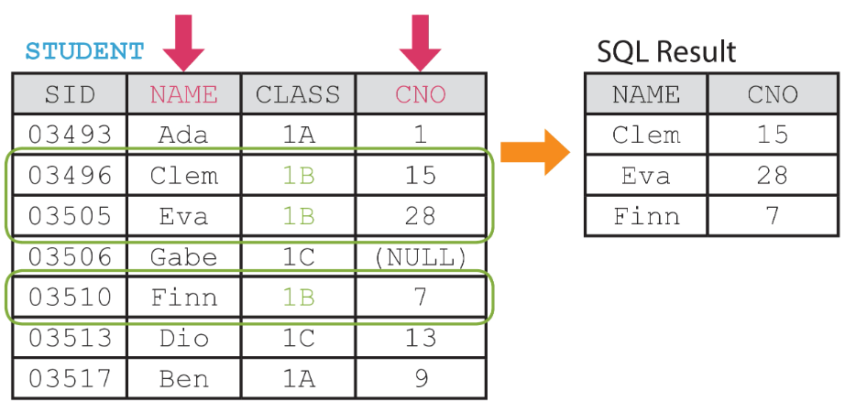
WHERE
C
When retrieving data, we may set criteria to filter records. The SQL statement below retrieves the data of students in class 1B.

Slide 36
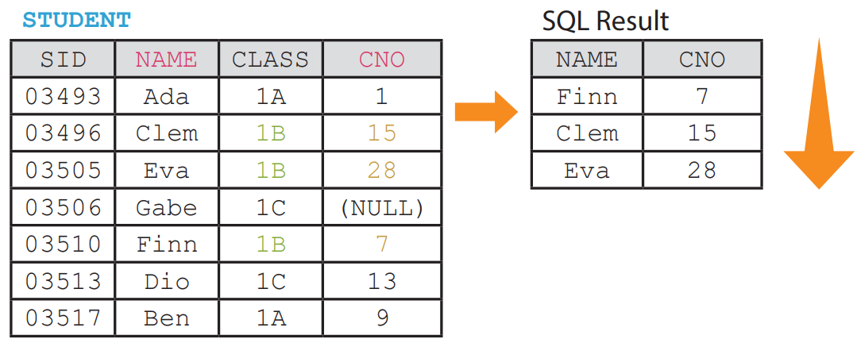
ORDER BY
D
When retrieving data, we may also set criteria to sort records. The SQL statement below retrieves the data of students in class 1B. The data is sorted by CNO in ascending order.

Slide 37
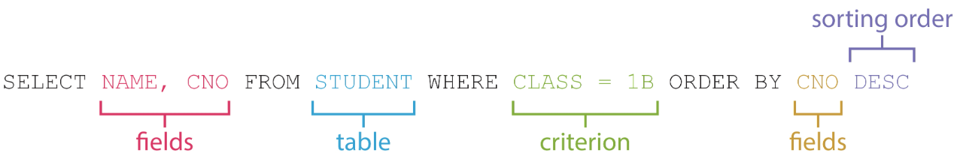
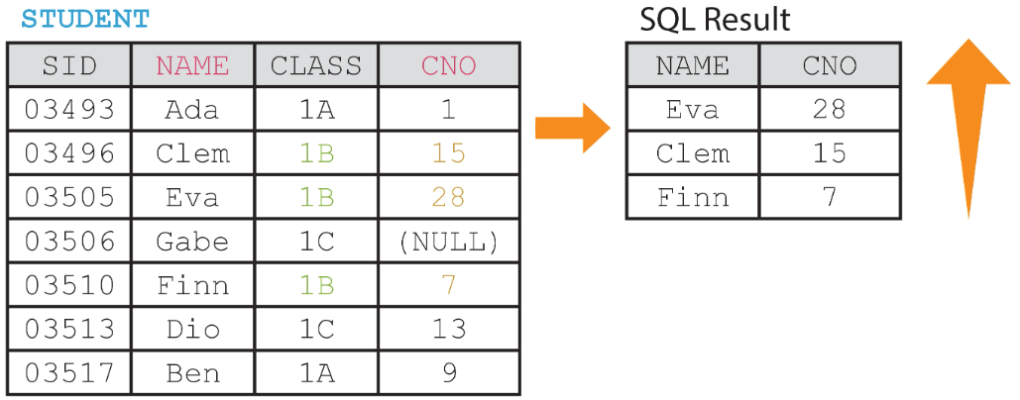
ORDER BY
D
Data can be sorted in either ascending order (ASC) or descending order (DESC).

Slide 38
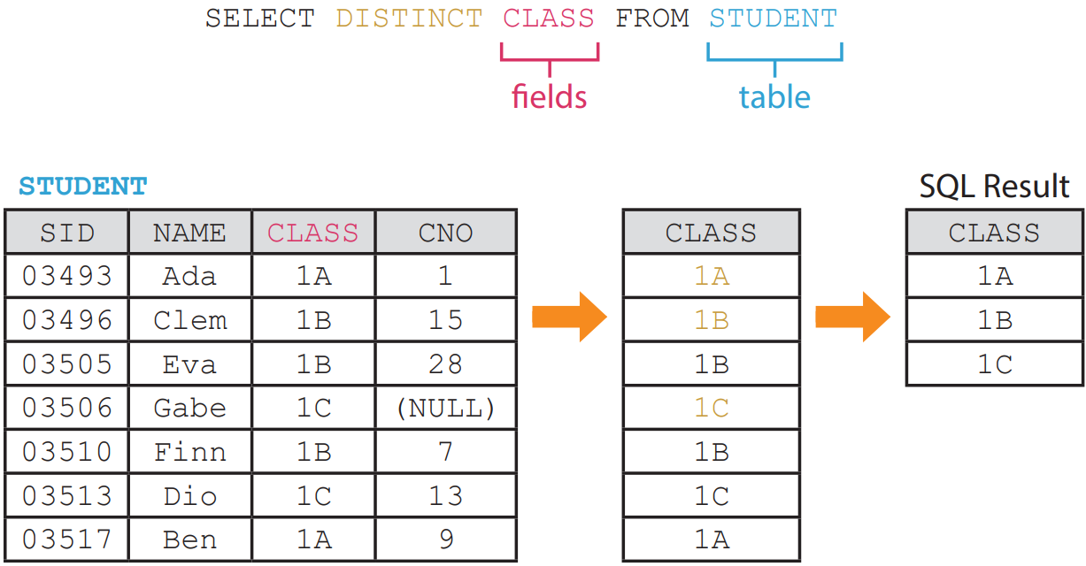
DISTINCT
E
We may filtered duplicated results by using DISTINCT.

Slide 39
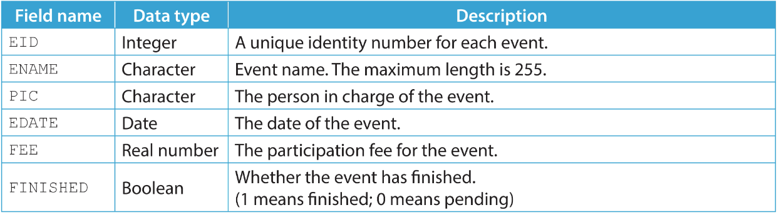
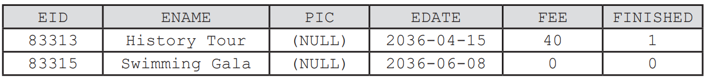
1.2
A teacher created a table named EVENT to store the data of school events. Here is the table structure of EVENT.
The first two records to be stored in the mentioned table are shown below.

Slide 40
1.2
(a) Write a SQL statement to insert the above two records into EVENT.
(b) Write a SQL statement to show the data of finished events.
(c) Write a SQL statement to show the name of the events sorted by the fee in descending order.

Slide 41
1.2
◣ Solution
(a) INSERT INTO EVENT (EID, ENAME, EDATE, FEE, FINISHED) VALUES
(83313, 'History Tour', '2036-04-15', 40, 1), (83315, 'Swimming Gala', '2036-06-08', 0, 0)
(b) SELECT * FROM EVENT WHERE FINISHED = 1
(c) SELECT ENAME FROM EVENT ORDER BY FEE DESC We may write 0 and 1 as FALSE and TRUE respectively when inserting Booleans or filtering by a Boolean field.

Slide 42
1.2
Finish Checkpoint 1.2 on P. 23 of your textbook.
(a) INSERT INTO MEMBER (MID, MNAME, MTYPE, AGE, CREDIT) VALUES
(23908, 'Ada Chan', 'Bronze', 26, 472.5),
(72330, 'Eva Wong', 'Gold', 23, 203.7)
(b) SELECT MTYPE FROM MEMBER WHERE MNAME = 'Ivy Chau'
(c) SELECT * FROM MEMBER WHERE MTYPE = 'Gold' ORDER BY AGE [ASC]
(d) SELECT DISTINCT MTYPE FROM MEMBER

Slide 43
Updating and Deleting Data
1.5
In this section, we are going to update and delete data from a table.

Slide 44
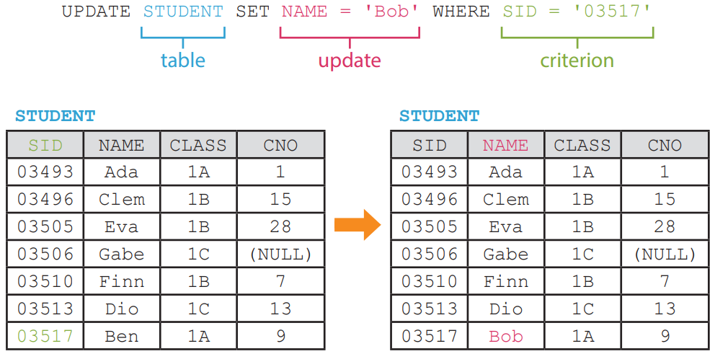
UPDATE … SET
A
The SQL statement below updates the name of a specific student in the table STUDENT.

Slide 45
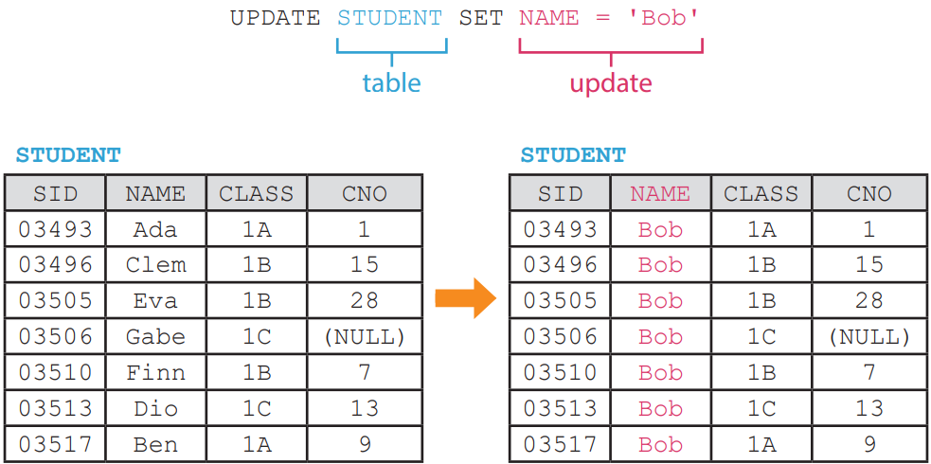
UPDATE … SET
A
Note that UPDATE usually comes with a WHERE clause, otherwise, it will update the whole table.

Slide 46
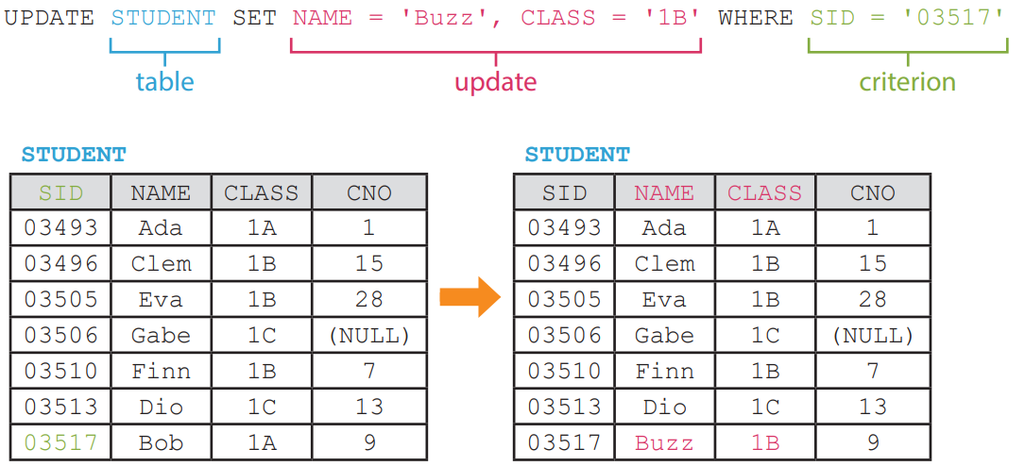
UPDATE … SET
A
The SQL statement below updates the name and the class of a specific student in the table STUDENT.

Slide 47
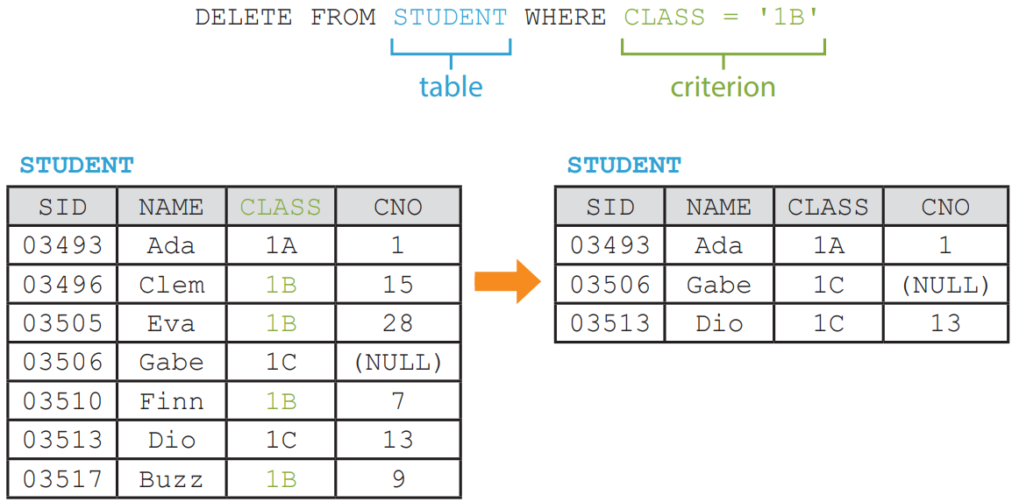
DELETE FROM
B
The SQL statement below deletes specific records in the table STUDENT.

Slide 48
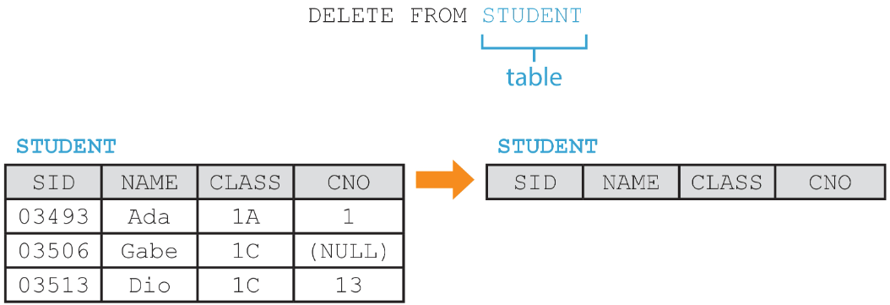
DELETE FROM
B
Using DELETE without a WHERE clause simply deletes all records from the table.

Slide 49

DROP TABLE
C
Assume that table STUDENT is not needed anymore. We are going to delete the whole table from the database using DROP TABLE.

Slide 50
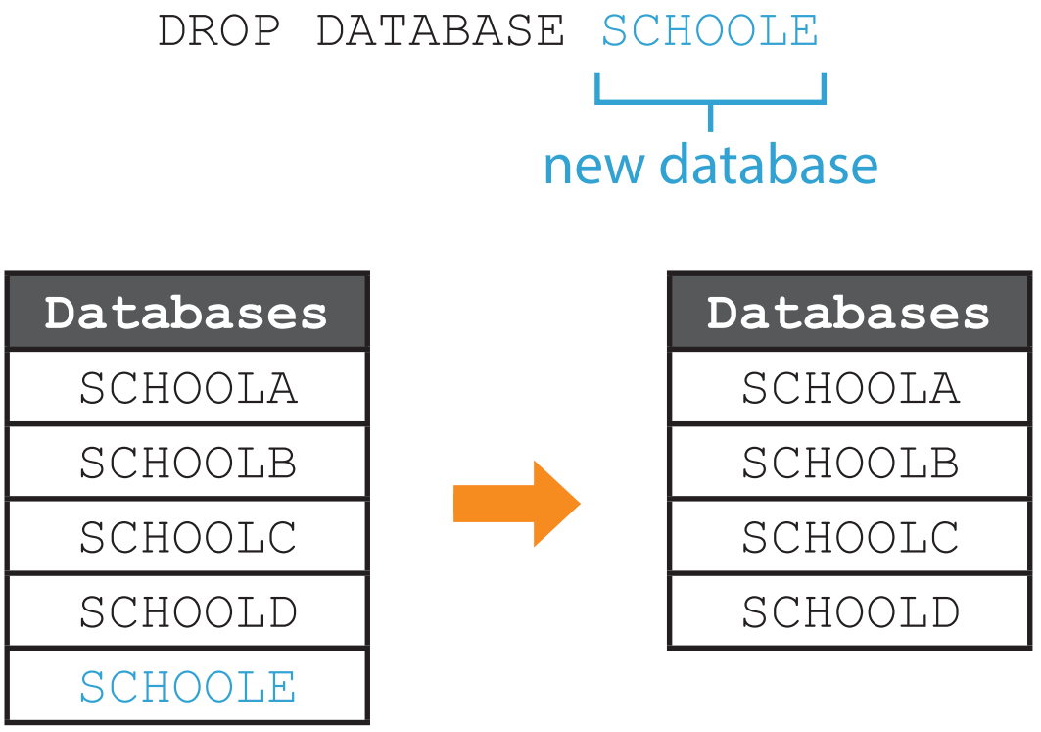
DROP DATABASE
D
Assume that database SCHOOLE is not needed anymore. We are going to drop the whole database using DROP DATABASE.

Slide 51
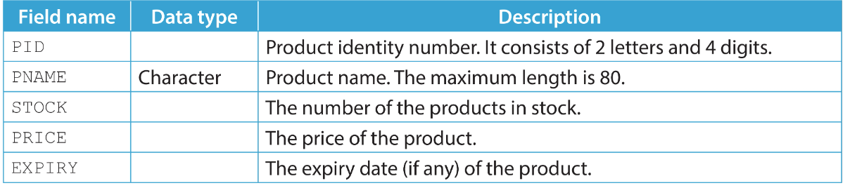
1.3
1. A retail store manager created a table named PRODUCT to store the data of products in the store.
(a) Here is the table structure of PRODUCT. Fill in suitable data types below.
(b) Write a SQL statement to create the above table.

Slide 52
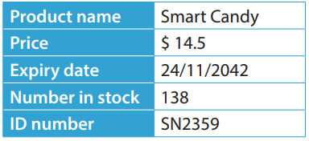
1.3
(c) Write a SQL statement to insert the data of the product below into the table.
(d) The product with an identity number of BA1100 is out of stock now. Write a SQL statement to update its record.

Slide 53
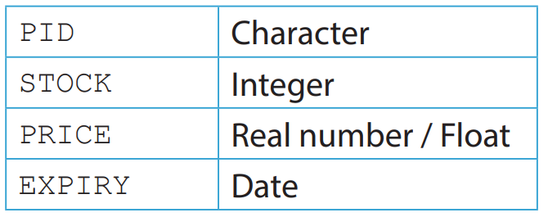
1.3
◣ Solution
(a)
(b) CREATE TABLE PRODUCT (
PID CHAR(6),
PNAME VARCHAR(80),
STOCK INT,
PRICE FLOAT,
EXPIRY DATE )
Though not recommended, PID and PRICE can also be VARCHAR(6) and DOUBLE respectively.

Slide 54
1.3
(c) INSERT INTO PRODUCT VALUES ('SN2359', 'Smart Candy', 138, 14.5, '2042-11-24’) Though not required, we may include the field names in the SQL statement.
(d) UPDATE PRODUCT SET STOCK = 0 WHERE PID = 'BA1100'

Slide 55
1.3
Finish Checkpoint 1.3 on P. 31 of your textbook.
(a) CREATE TABLE BOOK (BID CHAR(4), BOOKNAME VARCHAR(200),
AUTHOR VARCHAR(200), PUBDATE DATE, NUMPAGE INT, PRICE FLOAT)
(b) INSERT INTO BOOK [(BID, BOOKNAME, AUTHOR, PUBDATE, NUMPAGE, PRICE)] VALUES ('2012', '2012', 'Arthur White', '20-12-2012', 2012, 201.2)
(c) UPDATE BOOK SET PRICE = 12.4 WHERE AUTHOR = 'Sela Brooks'

Slide 56
Setting Constraints and Indexing
1.6
To maintain data integrity and validate data input, we should set constraints for a table.

Slide 57
PRIMARY KEY
A
Primary key is a field or a combination of fields that store unique data for every record. A table should always have a primary key to identify a record from all other records.
Moreover, the value stored in the primary key field cannot be empty, i.e. NULL.

Slide 58
1.4
Finish Checkpoint 1.4 on P. 32 of your textbook.
Field name | Possible to have duplications? | Available for everyone? | Possible to change?
HKID
ENAME
SEX | Yes. It is very common for people to have the same sex. |  | No. Biological sex is based on chromosome.
DOB |  | Yes. Everyone have a date of birth.
BANKAC |  | No. Some people do not have a bank account.
EMAIL | No. A personal email address is not supposed to be shared. |  | Yes. People can create email addresses for themselves.

Slide 59
1.4
Field name | Possible to have duplications? | Available for everyone? | Possible to change?
HKID | No. HKID number is unique for everyone. | Yes. Every Hong Kong citizen should have one. | No. HKID number is permanent.
ENAME | Yes. Some people may share the same name. | Yes. Every Hong Kong citizen has an English name. | Yes. People are allowed to change their names.
SEX | Yes. It is very common for people to have the same sex. | Yes. Everyone have a biological sex. | No. Biological sex is based on chromosome.
DOB | Yes. Some people may share the same date of birth. | Yes. Everyone have a date of birth. | No. Date of birth cannot be changed.
BANKAC | No. A personal bank account number is unique for everyone. | No. Some people do not have a bank account. | Yes. People can create bank accounts for themselves.
EMAIL | No. A personal email address is not supposed to be shared. | No. Some people do not have an email address. | Yes. People can create email addresses for themselves.

Slide 60
1.4
Based on the definition of primary key, which of the above fields should be the primary key of the table HKCITIZEN?
HKID

Slide 61
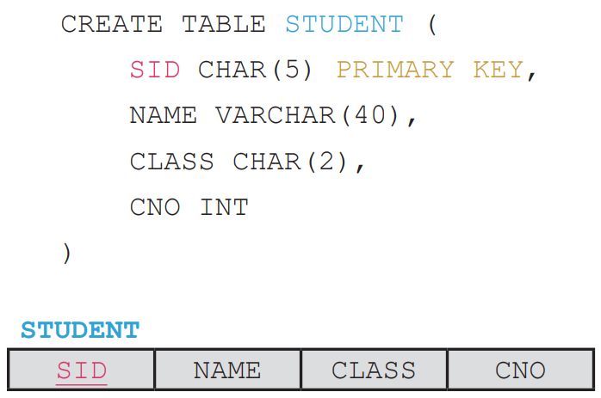
PRIMARY KEY
A
The SQL statement below creates a table named STUDENT, where SID is set as the primary key by the keyword, PRIMARY KEY.

Slide 62
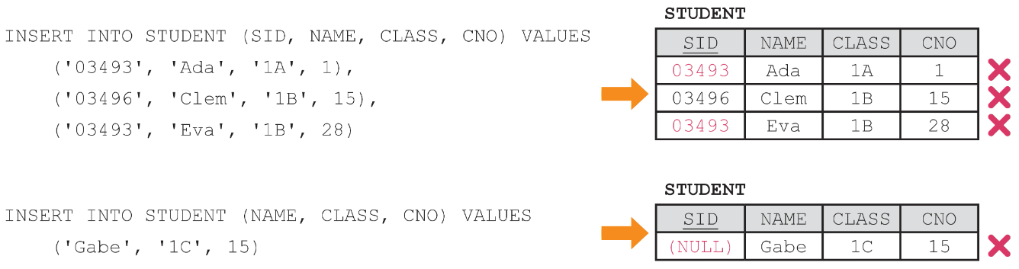
PRIMARY KEY
A
Constraint PRIMARY KEY prevents a field from storing duplicated values or NULL by any means, including insertion and updating.
No record will be inserted into the table STUDENT after executing the above two SQL statements.

Slide 63
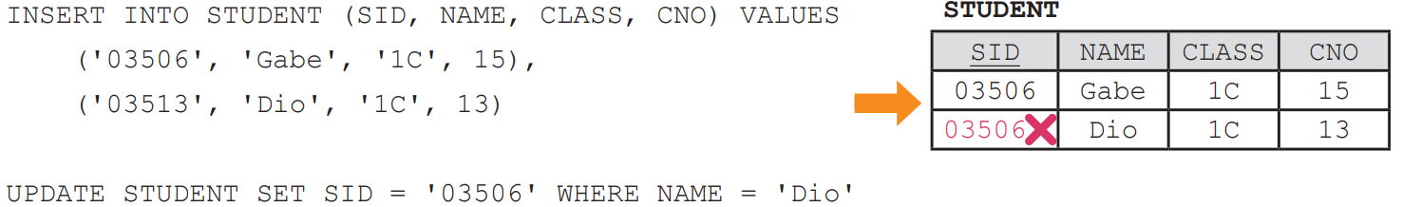
PRIMARY KEY
A
Two records are inserted into the table. However, the update attempts to set the SID of a record to an existing SID.
This update results in an error due to the constraint PRIMARY KEY.

Slide 64
PRIMARY KEY
A
We may also set a combination of fields as the primary key of the table. Such a primary key is called a composite key.

Slide 65
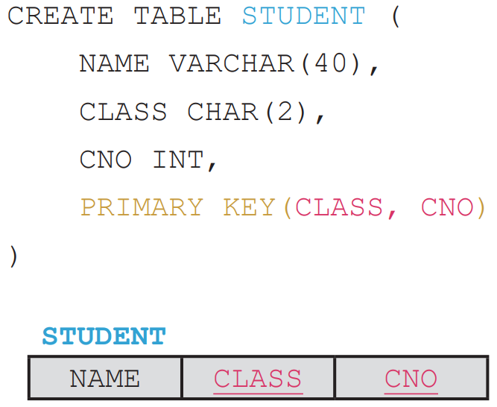
PRIMARY KEY
A
The SQL statement below creates a table named STUDENT, where CLASS+CNO is set as the primary key by the keyword, PRIMARY KEY.

Slide 66
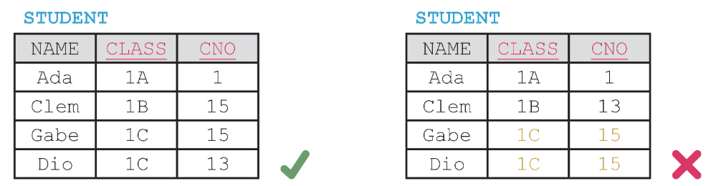
PRIMARY KEY
A
Under this constraint, every combination of the class and the class number of a student must be unique.

Slide 67
FOREIGN KEY
B
Foreign keys are used to show the relationship between records in two tables. A foreign key in a table X is always the primary key of another table Y.
In this relationship, table X is considered as the host table, while table Y is considered as the parent table.

Slide 68
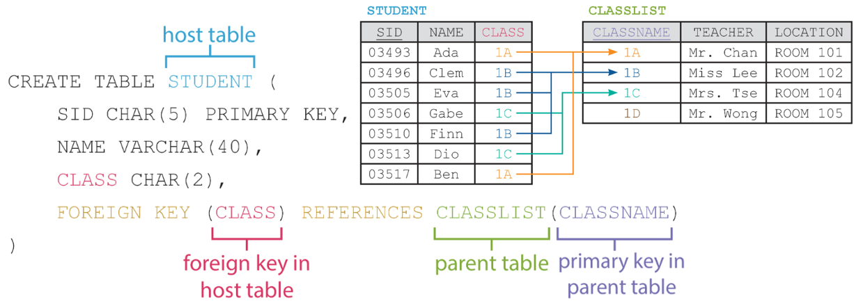
FOREIGN KEY
B
The SQL statement below creates a table named STUDENT, where CLASS is set as the foreign key by the keyword, FOREIGN KEY.

Slide 69
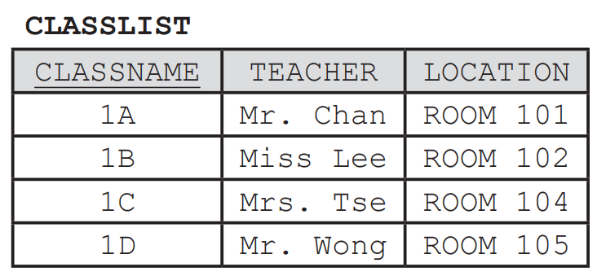
FOREIGN KEY
B
Constraint FOREIGN KEY prevents a field from storing a value that does not exist in corresponding field of the parent table by any means, including insertion, update and deletion.
Assume there are class 1A, 1B, 1C and 1D in the table CLASSLIST.

Slide 70
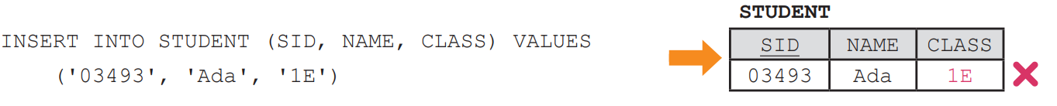
FOREIGN KEY
B
No record will be inserted into the table STUDENT after executing the above SQL statement.

Slide 71
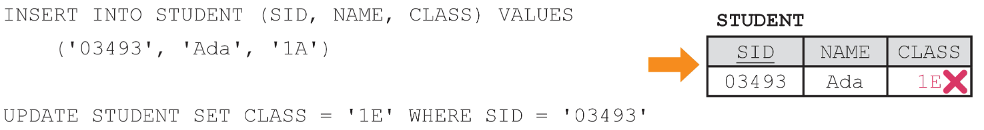
FOREIGN KEY
B
One records are inserted into the table. However, the update attempts to set the CLASS of a record to a non-existing class. This update results in an error due to the constraint FOREIGN KEY.

Slide 72
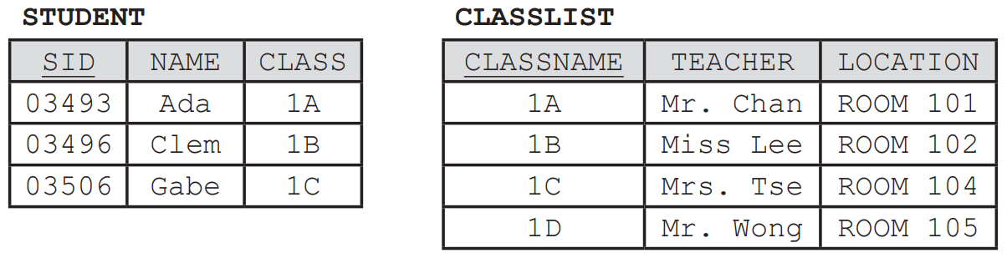
FOREIGN KEY
B
Consider the following data in STUDENT and CLASSLIST.

Slide 73
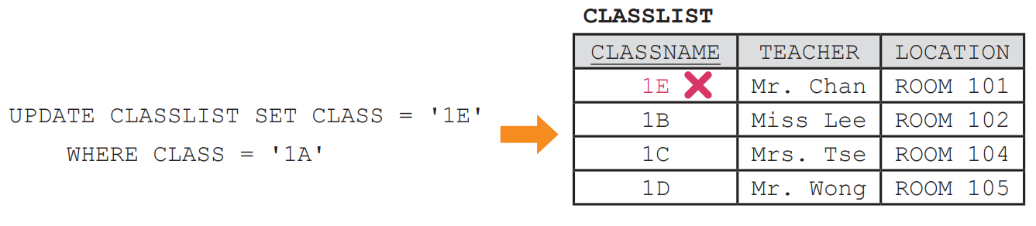
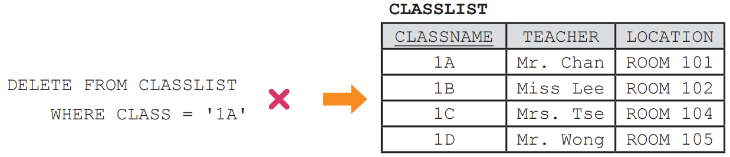
FOREIGN KEY
B
Since there is at least one student from class 1A in STUDENT, class 1A in CLASSLIST cannot be renamed to 1E, nor can it be deleted.

Slide 74

Other constraints
C
There are other constraints in MySQL. They are useful for data validation and shorten our time for data management.
Here is a table named STUDENT1A created by the following SQL statement. This table stores the data of students from Class 1A.

Slide 75

1.4
1. A game store manager wants to create a table named GAME to store the data of video games sold in the store.
Here is the table structure of GAME.

Slide 76

1.4
(a) Name a field that is suitable to be the primary key of the table GAME.
Here is the table structure of two related tables.
(b) Name two fields that are suitable to be the foreign keys of the table GAME.

Slide 77
1.4
(c) Assume that PCODE, GCODE and GNAME cannot be empty. Finish the following SQL statement to create the table GAME.
CREATE TABLE GAME ( PCODE ___________, GCODE ___________, GID ___________, GNAME VARCHAR(255) ___________, GENREID INT, ___________, FOREIGN KEY (___________) REFERENCES ___________ (CODE), FOREIGN KEY (___________) REFERENCES GENRE ___________)
(d) One of the fields in GAME is redundant. Which one is it? What change should be done if that field is dropped?

Slide 78
1.4
◣ Solution
(a) GID.
(b) PCODE and GENREID.
(c) CREATE TABLE GAME ( PCODE CHAR(2) NOT NULL, GCODE CHAR(3) NOT NULL, GID CHAR(5) PRIMARY KEY, GNAME VARCHAR(255) NOT NULL, GENREID INT, PRICE FLOAT, FOREIGN KEY (PCODE) REFERENCES PUBLISHER (CODE), FOREIGN KEY (GENREID) REFERENCES GENRE (ID))
(d) GID. The table should use PCODE+GCODE as the primary key instead.

Slide 79
1.4
Finish Checkpoint 1.4 on P. 41 of your textbook.
(a) SID for GAME and PHONE for MANAGER.
(b) CREATE TABLE SHOP ( SID INT PRIMARY KEY , SNAME VARCHAR(255) UNIQUE NOT NULL , OPEN TIME NOT NULL DEFAULT '09:00’ , PHONE CHAR(8) NOT NULL , SEX CHAR(1), FOREIGN KEY (PHONE) REFERENCES MANAGER (PHONE) , CHECK (OPEN >= '08:00' ) )
(c) SEX. This piece of data can be found in MANAGER.

Slide 80
Altering Table Structure
1.7
After creating a table, its structure can still be altered. We can add, modify or drop fields and constraints.
Note that some of the alterations may result in data loss so we should proceed with caution.

Slide 81

Renaming tables
A
Assume that a table has its name spelt wrong, we may use the following SQL statement to rename it.

Slide 82

Adding fields
B
Assume that the table STUDENT does not have a field for storing the student names. We may use the following SQL statement to add this field.

Slide 83

Adding fields
B
We may include constraints when adding a new field, just like how we define a field when creating a table.

Slide 84

Modifying fields
C
Assume that a field has its name spelt wrong, we may use the following SQL statement to rename it.

Slide 85

Modifying fields
C
Assume that SID is supposed to be an integer field, we may use the following SQL statement to change its data types.

Slide 86

Dropping fields
D
Assume that CNO is no longer needed, we may use the following SQL statement to drop it.

Slide 87

Adding and dropping constraints
E
When adding constraints, all existing data must not violate the constraints to be added, otherwise, such an operation will fail. We may set the primary key by adding a constraint.

Slide 88

Adding and dropping constraints
E
We may also set the primary key by redefining an existing field. Such a method yields the same result as the previous one does.
However, it requires you to input the data type. It cannot set a composite key as the primary key too.

Slide 89

Adding and dropping constraints
E
We may use the following SQL statement to drop the primary key.

Slide 90

Adding and dropping constraints
E
We may use the following SQL statement to set a foreign key.

Slide 91

Adding and dropping constraints
E
Since there can be more than one foreign key in a table, when dropping a foreign key, we need to specify which one to drop.
Each foreign key has a constraint name in DBMS. To find out which is which, we may use SHOW CREATE TABLE.

Slide 92


Adding and dropping constraints
E
The SQL statement should return a result like below:
We may use the following SQL statement to drop the foreign key.

Slide 93

1.5
1. The administrator of an online shopping website uses a table named USER to store the data of the website users.
Here is the table structure of USER.
The administrator tries to set two types of membership for the users. These two types are “Regular” and “Premium”. All users are Regular users by default.
(a) Write a SQL statement to add a field named MTYPE into the table USER. The default value of this field should be 'Regular'.

Slide 94
1.5
Six months later, the administrator decides to set not two but four types of membership for the users. These four types are, in order, “Regular”, “Bronze”, “Silver” and “Gold”.
(b) All Premium users shall be changed to Bronze users. Write a SQL statement to update the records of all Premium users.
(c) (i) The administrator wants to view the data of all users sorted by the membership type in ascending order. Write a SQL statement to retrieve the corresponding data.
(ii) How will the membership type be sorted by the above SQL statement? Write the membership types in order.

Slide 95

1.5
The administrator creates a table named MTYPELIST to store all the membership types.
Here is the table structure of MTYPELIST.
(d) Now MTYPE in USER stores the identity numbers of the membership type instead. Write a SQL statement to change MTYPE into an integer field.
(e) Write a SQL statement to set MTYPE in USER as a foreign key.

Slide 96
1.5
◣ Solution
(a) ALTER TABLE USER ADD MTYPE CHAR(7) DEFAULT 'Regular’
(b) UPDATE USER SET MTYPE = 'Bronze' WHERE MTYPE = 'Premium’
(c) (i) SELECT * FROM USER ORDER BY MTYPE [ASC]
(ii) Bronze, Gold, Regular and Silver.
(d) ALTER TABLE USER MODIFY MTYPE INT
(e) ALTER TABLE USER ADD FOREIGN KEY (MTYPE) REFERENCES MTYPELIST(TID)

Slide 97
1.5
Finish Checkpoint 1.5 on P. 49 of your textbook.
(a) ALTER TABLE BOOKCLUB DROP HKID
(b) No. MEMID would be NULL / 0 for all records in BOOKCLUB if it is added successfully. However, the PRIMARY KEY constraint forbids the value of a primary key to be NULL/ duplicated.
(c) ALTER TABLE BOOKCLUB ADD SCORE FLOAT DEFAULT 55.5
(d) ALTER TABLE BOOKCLUB ADD CHECK (SCORE > 10)
(e) CREATE TABLE BCGROUP (GNUM INT, GNAME VARCHAR(50), NEXTMEET DATETIME)
(f) ALTER TABLE table ADD FOREIGN KEY (BCGROUP) REFERENCES BCGROUP (GNUM)

